Slide 1





Road Sign and Road State Mobile Notification Application
TASK IV: SYSTEM MODELING AND DESIGN

Slide 2
Table of contents
01
03
02
04
Introduction
Design
Modeling
Conclusion

Slide 3

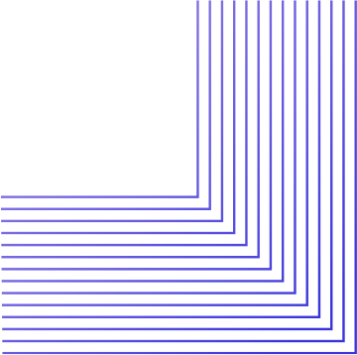
01
Introduction
What is Sytem Modeling and Design?

Slide 4
System Modeling
System modeling is the process of developing abstract models of a system, with each model presenting a different view or perspective of that system.
Usecase
Context
Class
Sequence
Deployment

Slide 5
System Design
Based on the system models, this phase focuses on how the system will be built. It involves
Choosing technologies
Designing system architecture

Slide 6
Why do we need System Modeling and Design?
Improved Communication
Early detection of Issues
Clear Road Map

Slide 7
02
Modeling the System

Slide 8
1.1
Usecase Diagram
1.4
Sequence Diagram
1.2
Context Diagram
1.5
Deployment Diagram
1.3
Class Diagram

Slide 9





2.1
Usecase Diagram
System Actors
Usecases
Users
Firebase
GPS System
Google map api
Database
Login
Set a route
View Notifications
Change settings
Provide feedback

Slide 10
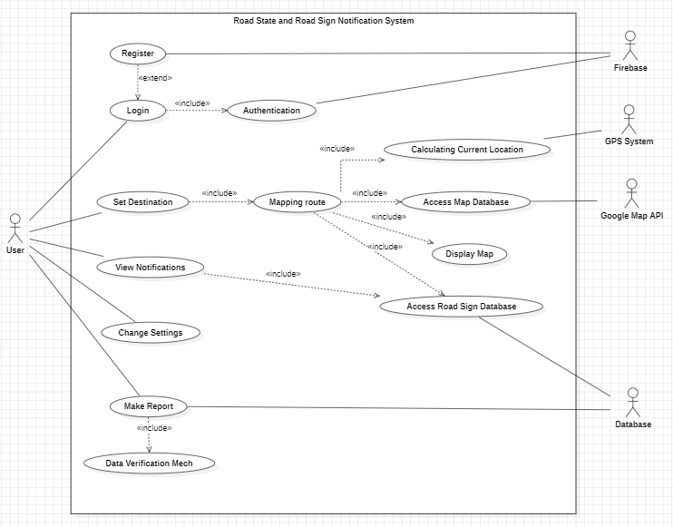

Slide 11
2.2
Context Diagram
The Entities
Users
Traffic Data provider
Road Sign database
User Authentication service

Slide 12
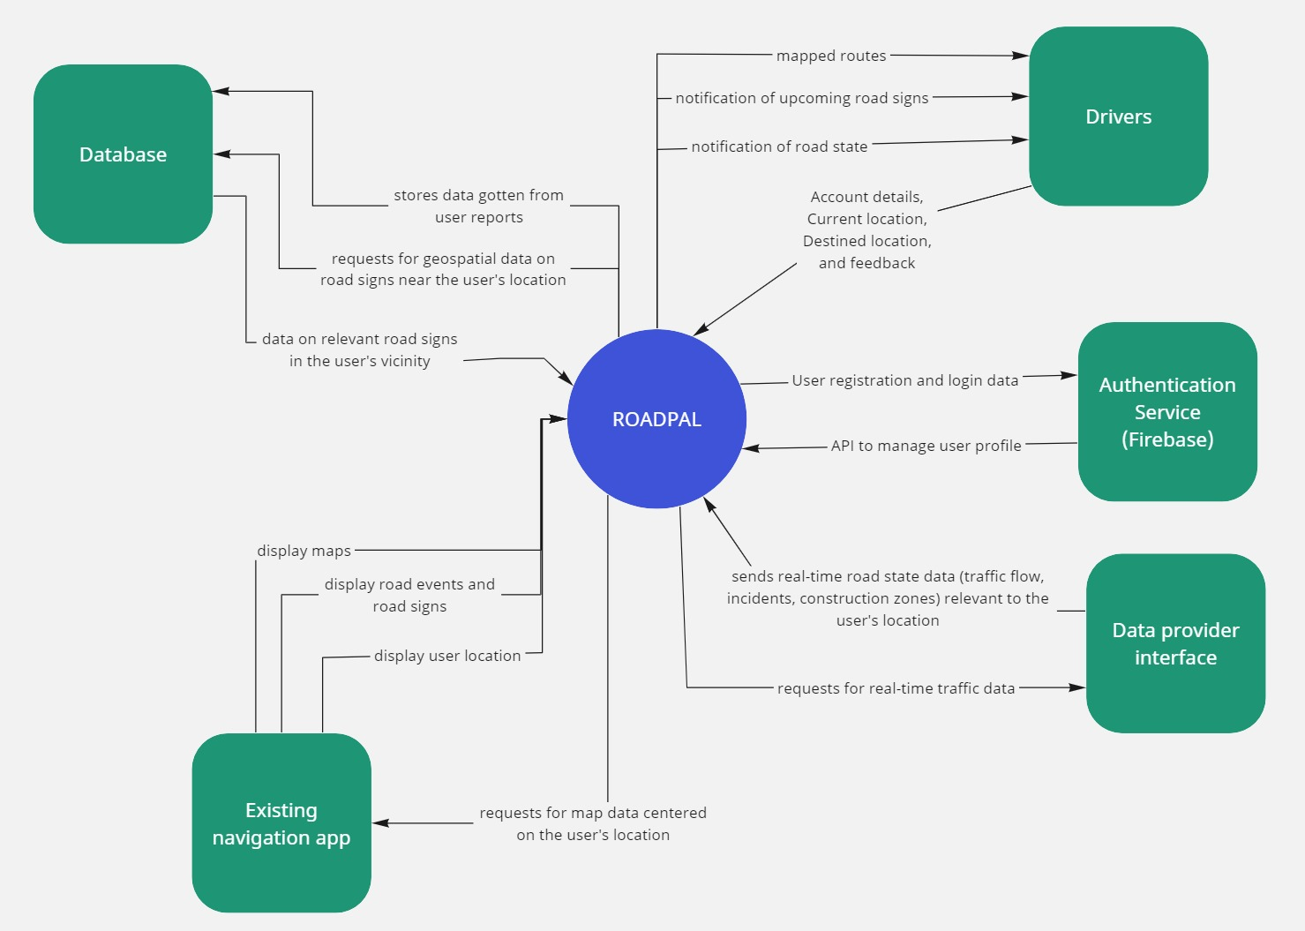

Slide 13

Class Diagram
2.3
Classes
User
Route
Notification
Feedback
RoadState
RoadSign

Slide 14
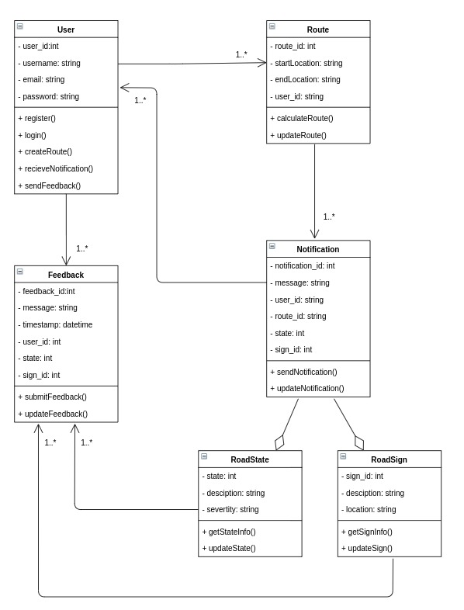

Slide 15
2.4
Sequence Diagram
Sequences
Login and Registration
Make route
Road State and Road sign Notification
Make report
Changing Settings

Slide 16
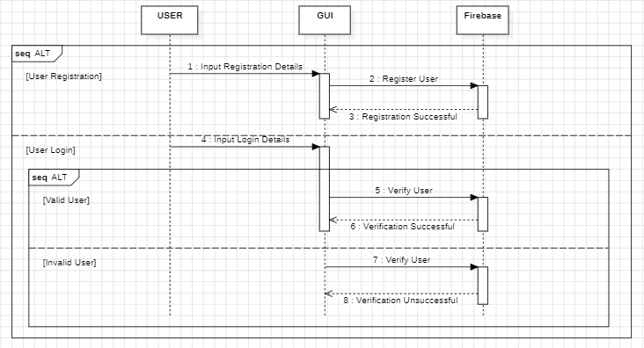
User Login / Registration

Slide 17
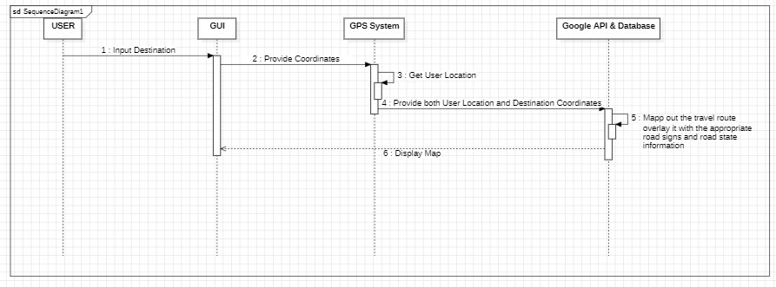
Make Route

Slide 18
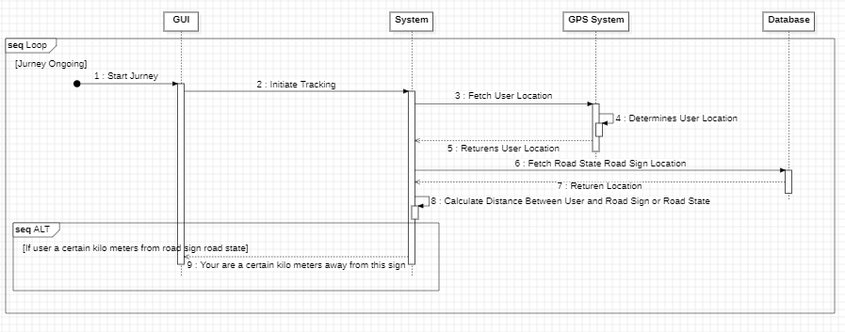
Notification

Slide 19
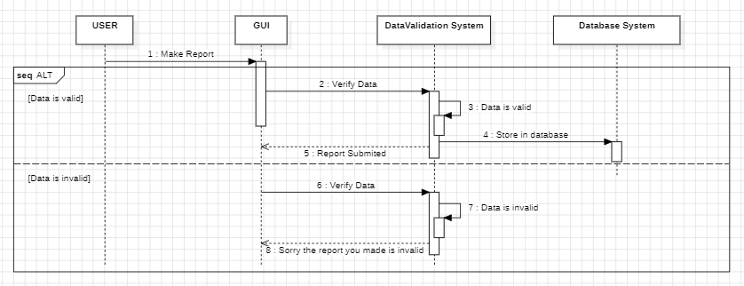
Make a Report / Feedback

Slide 20
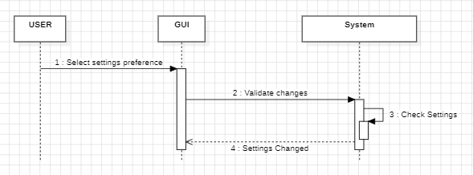
Change Settings

Slide 21
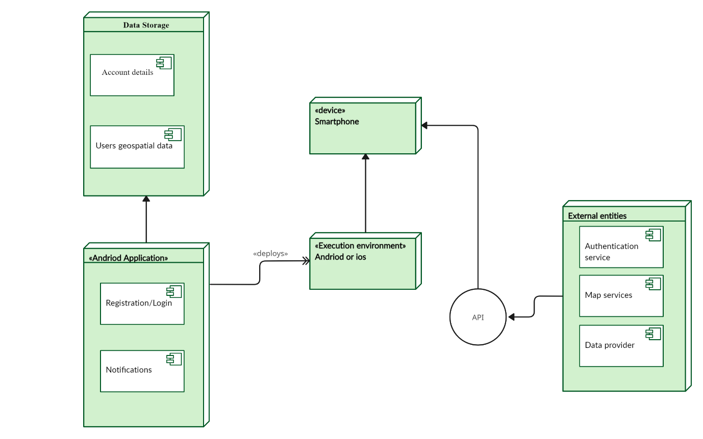
2.5
Deployment Diagram

Slide 22
03
Design of the System
Required functionalities, interfaces, and performance

Slide 23
Selecting Appropriate Technologies
Framework
Local Services
Road State Data Acquisition
The framework which will be used is React Native. This is because it allow development using a single codebase for both iOS and Android.
The application will leverage the device's built-in GPS capabilities to determine the user's location.
APIs provided by traffic management agencies or crowd-sourced traffic data platforms can be integrated to access real-time road state information.

Slide 24
Selecting Appropriate Technologies
Road Sign Recognition
Notification System
Other Technologies
The app can leverage the device's built-in notification framework to deliver visual and audio alerts to users.
Alternatively, the app can utilize a pre-loaded database containing geospatial data on road signs, reducing on processing power
Integration with existing mapping APIs (e.g., Google Maps) simplifies displaying the user's location, road events, and potentially road signs.

Slide 25
Designing system architecture
The Model-View-Presenter (MVP) architectural pattern can be effectively applied to design our Road State and Road Sign Notification Mobile App.

Slide 26
Model
Encapsulates the data layer and business logic of the application.
Responsibilities include:
Accessing real-time road state data through external APIs.
Processing and interpreting the acquired data.
Storing user preferences (potentially using the Data Access Layer).

Slide 27
View
Represents the user interface (UI) elements of the application.
Responsibilities include:
Displaying the map view with user location and road events (traffic flow, incidents, construction zones).
Showing upcoming road sign notifications.
Presenting user settings for notification preferences and sign categories.

Slide 28
Presenter
Acts as the intermediary between the View and the Model.
Responsibilities include:
Receiving user interaction events from the View.
Fetching data from the Model based on user location and preferences.
Processing the retrieved data and preparing it for presentation.

Slide 29

Benefits of MVP
Separation of concerns
Testability
Loose coupling
Flexibility

Slide 30


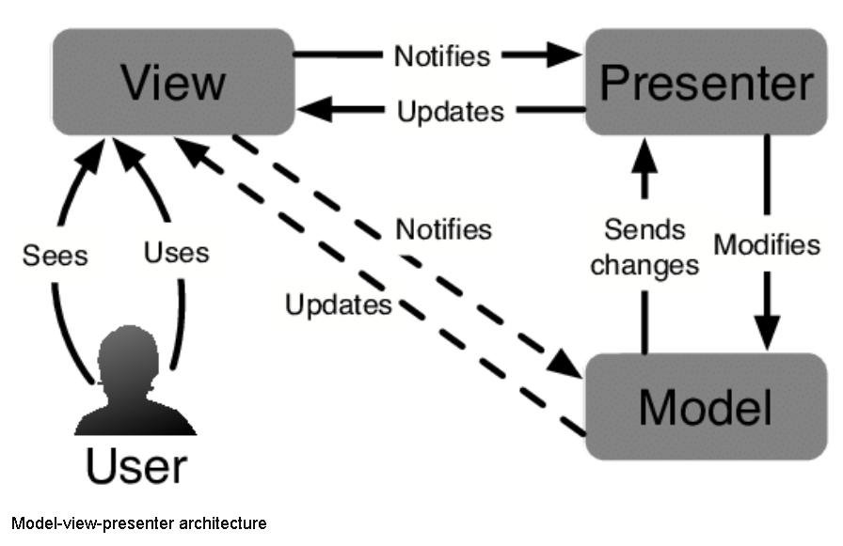
Implementation

Slide 31
04
Conclusion
No System is Perfect! treat every every iteration as a prototype.

Slide 32

Thanks!
Do you have any questions?
Github: github....

Slide 33
References
•https://www.visual-paradigm.com/guide/uml-unified-modeling-language/what-is-deployment-diagram/
•https://www.geeksforgeeks.org/what-is-system-design-learn-system-design/
•https://venngage.com/blog/context-diagram/
•https://medium.com/@brainbeanapps/designing-the-architecture-of-your-mobile-product-4-patterns-to-choose-among-d47b7d3c2e06

